Slide 1
Principles on Investment and Financing
for Water-related Disaster Risk Reduction
April 23, 2019
Tomoyuki OKADA
High-level Experts and Leaders Panel on Water and Disasters (HELP)
Ministry of Land, Infrastructure, Transport and Tourism, Japan

Slide 2
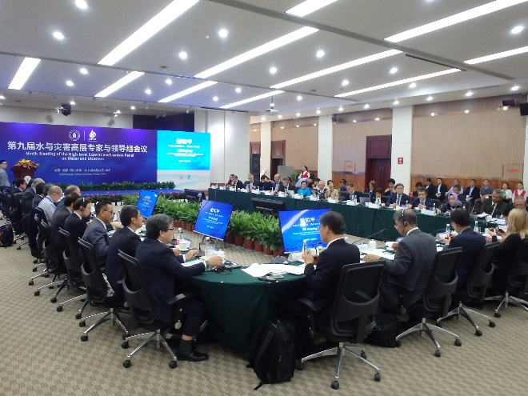
High-level Experts and Leaders Panel on Water and Disasters (HELP)
Objectives: Assist the international community, governments and stakeholders in mobilizing political will and resources, and take effective measures to address the issues of water and disasters.
Chair: Dr. Han, Seung-soo (Special Envoy of the UN Secretary-General for Disaster Risk Reduction and Water, Former Prime Minister of the Republic of Korea)
Members: France, Indonesia, Japan, Myanmar,
Netherlands, South Korea, Thailand, US,
ADB, EU, AMCOW, JICA, NARBO, OECD,
UNESCO, UNISDR, WB, GWP, WWC, and Others.
2

Slide 3
Goal of the Principles
Double the investment and financing for water-related disaster risk reduction.
Shift international assistance from disaster response to preparedness.
 | Current |  | Goal
Emergency Response/ Rehabilitation | 90% | 50% | 10%
Disaster Risk Reduction/ Preparedness | 10% | 50% | 90%
3
Notes:
The proportion of financing in international assistance for disaster risk reduction/preparedness and that for emergency response/rehabilitation will shift from the current 10%:90% to 90%:10%.
3

Slide 4
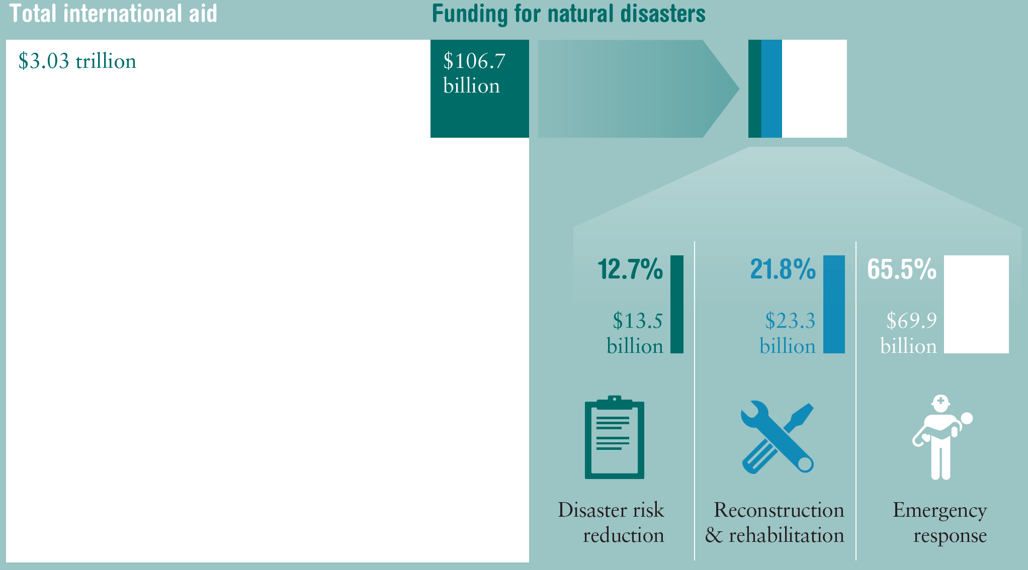
Disaster Financing as a Proportion of
Total International Aid 1991- 2010
Source: ODI & GFDRR
4
Notes:
4
Overseas Development Institute
4

Slide 5
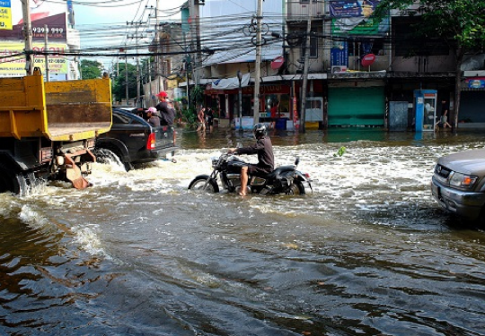
I. Water-related disaster risk reduction is indispensable for socio-economic development.
Water-related disasters can be prevented or mitigated by disaster prevention infrastructure, including levees, reservoirs, resilient infrastructure, or green infrastructure.
Countermeasures implemented in advance against water-related disasters are not a cost, but an investment for the future.
Water-related disaster risk reduction is a key component of Integrated Water Resources Management (IWRM), providing multi-faceted benefits, such as efficient water use and enhanced biodiversity.

Slide 6
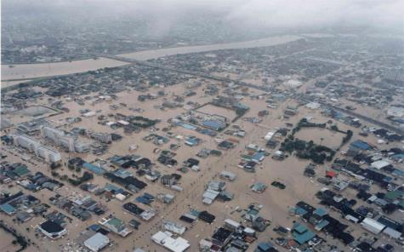
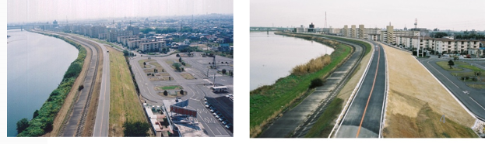
Effect of Preventive Measures
Tokai Storm Flood (September, 2000)
Total Economic Loss
JPY 771 Billion (about USD 7 Billion)
670
Billion
yen
Effect of prevention
project:
550 billion yen
Effectiveness
7.7
(=550/71.6)
120
Billion yen
71.6 billion yen
Example of Countermeasure: Levee Reinforcement
Actual damage
to general assets
Simulated
damage from same heavy rain after the completion of prevention
measures
Cost of prevention measures after disaster
6
Notes:
6

Slide 7
II. Pre-disaster prevention measures should be prioritized.
7
Frequent water-related disasters should be forestalled by preventive structural measures at lower cost than recovery.
Devastating damages to society and economy should be prevented, while prioritizing the protection of human lives.
“Build Back Better” approach should be incorporated into recovery and reconstruction.
Various sectors should support “mainstreaming disaster risk reduction.”
Climate change is predicted to intensify disaster damages. Investment should be enhanced for adaptation measures.
Investment for the maintenance and management of infrastructure should be secured to cope with its aging issues.

Slide 8
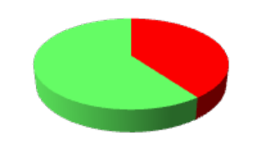
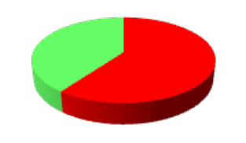
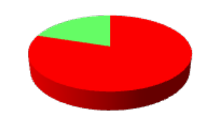
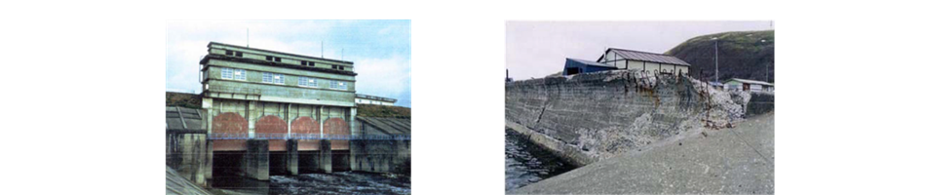
Management of Aging Infrastructure
Ratio of River Facilities that Passed 40 Years in Japan
Year 2011 2021 2031
As the number of aging infrastructure is rapidly increasing, disaster risk is growing.
40% 60% 80%
Problems of Aging Infrastructure
Aging Gate
Aging Coastal Levee
8

Slide 9
III. Governments should improve their fiscal systems and secure sufficient budget.
Governments must prepare the legal, budgetary and administrative systems for disaster risk reduction. The central government should assist local governments whose capacities are overwhelmed by disasters.
Responsibilities of all stakeholders, including residents, local and central governments, should be defined, empowering the local governments and communities.
Local and central governments should secure and record budget for pre-disaster risk reduction.
Emergency reserve fund can be swiftly disbursed after disasters.
9

Slide 10
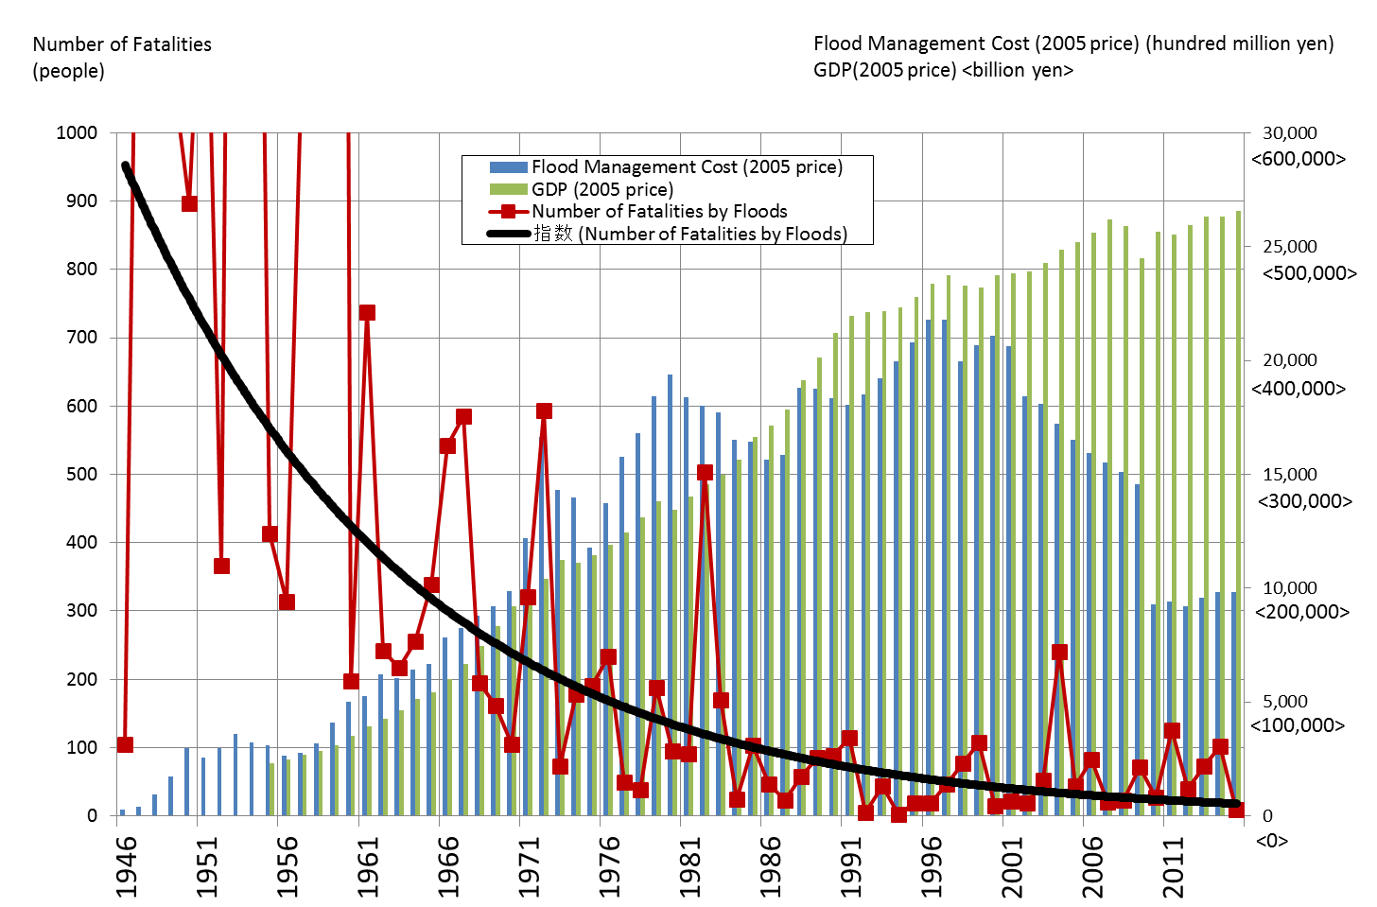
Effect of Flood Management Investment
Fatalities by Floods , GDP, and Flood Management Budget in Japan
10
Note: Number of fatalities exclude tsunami disasters.
Notes:
Due to decades-long steady investment in flood prevention measures, the number of fatalities shows a downward trend.

Slide 11
IV. Various funding sources should be mobilized.
Mobilization of private funds can support increasing demand for resilient infrastructure. Cooperation with other sectors, such as water resources management and urban planning, helps diversify funding.
Incentives for awareness raising and self-prevention measures by the private sector should be explored with subsidies and tax exemptions.
Flood insurance is effective for the speedy recovery of daily life. However, it does not physically reduce flood risks.
11

Slide 12
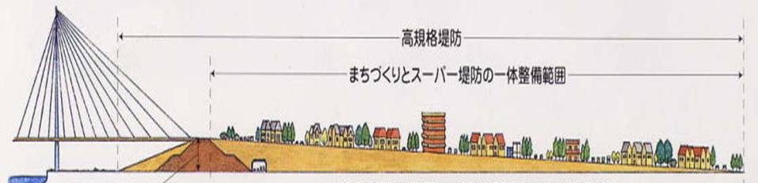
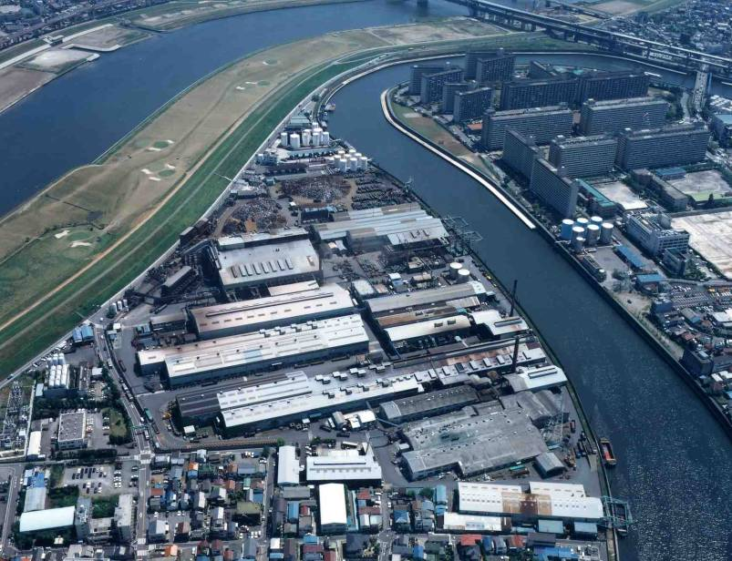
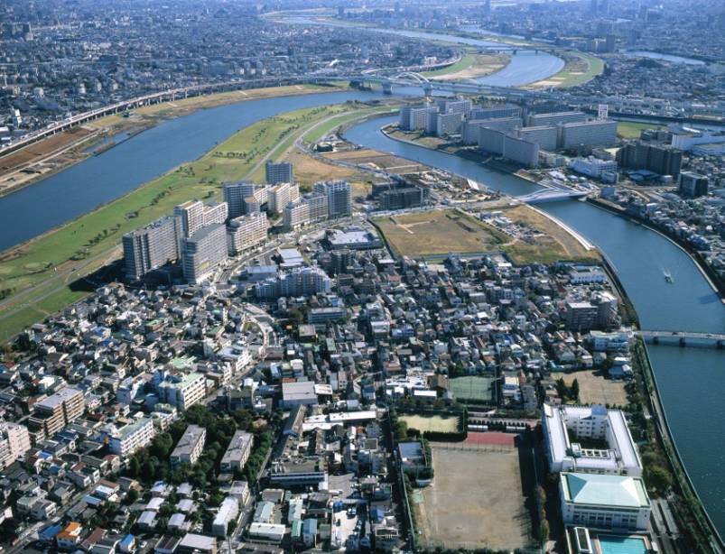
High-Standard Levee Development with the Private Sector
High-standard Levee
Urban Development on the Levee
Arakawa River and Shinden district in Adachi City
Before project
After project
12
Notes:
・この堤防の利点は，万一洪水が発生したり，越水しても，堤防が壊れないようにしたり，耐震性を持っていることがあります．
・また，堤防整備にあたっては，市街地の再開発と連携して実施しています．
Excavation
The advantages of super embankments are no collapse at floods, no collapse against inundation, and earthquake-resistant.
When this embankment are constructed, the plan is executed in accordance with the re-development plan of urban area.

Slide 13
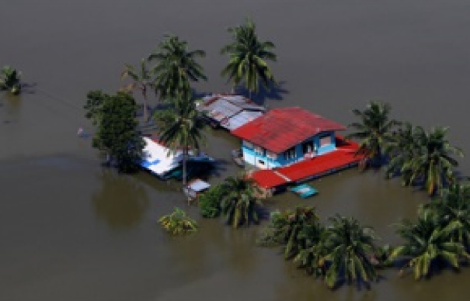
V. International community should expand financing for disaster risk reduction.
13
International cooperation in disaster prevention should be strengthened under the international frameworks. Even a single disaster in one country creates ripple effects to the world through supply chains, migration, etc.
Surplus fund in emergency assistance should be utilized for further disaster risk reduction.

Slide 14
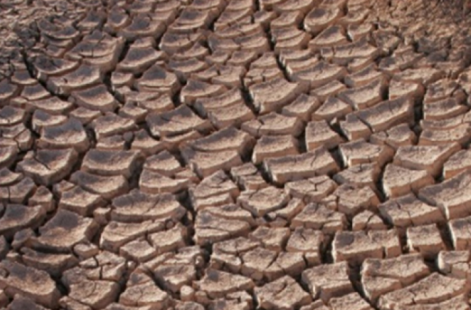
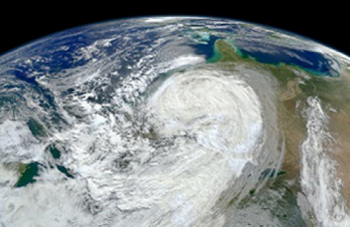
VI. Science and technology should support decision making on better investment.
14
Data and knowledge on disaster losses and impacts should be improved to evaluate the effectiveness of investment.
Cooperation and alliances among science communities should be enhanced.

Slide 15
Roadmap for Developing the Principles
2017
2018
・・2028
Drafting & Discussion
Consultation & Launch
Monitoring
3rd UN Session
Jul. 2017
WWF8
Mar. 2018
Water Decade
(2018–2028)
WWW
Aug. 2017
HELP11
May 2018
HLPF
Jul. 2018
HELP12
Nov. 2018
HELP10
Sep. 2017
Dushanbe HLC
Jun. 2018
WWW
Aug. 2018
4th UN Session
Jun. 2019
APWS3
Dec. 2017
AMCDRR
Jul. 2018
GWP
2018-19
15

Slide 16
Consultations on the Principles
Objectives
Collect comments on the proposed Principles from various stakeholders
Formulate the Implementation Plan of the Principles
Organizers
HELP
Global Water Partnership (GWP)
Participants
Governments, International organizations, Academia, NGOs, Private sectors, etc.

Slide 17
Schedule of Consultations
Year 2018
October 9 GWP Central/Eastern Europe Meeting in Bucharest
October 12 GWP South Asia Meeting in Colombo
October 31 GWP Southern Africa Meeting in Livingstone
November 27 12th HELP Meeting in Tokyo
Year 2019
March 1 I&W/OECD Meeting in Paris
March 22 GWP Southeast Asia Meeting in Hanoi
April 18 2nd I&W/OECD Meeting in the Hague
April 23 GWP South America Meeting in Montevideo
June 24 4th UN Special Session on Water and Disasters in NY
Launch of the Principles & its Implementation Plan

Slide 18
Brain Storming Session
You are asked to:
1. Reading and writing
Read the Principle on Financing and Investing for DRR
Think and write your comments on the Principle
2. Group Discussion
Choose a moderator and rapporteur of the Group
Share your idea in group discussion
Discuss and decide the most important suggestion on the principle (changes, additions, new ideas…) of the group.
3. Plenary discussion
Rapporteurs to report the most important suggestion in the plenary discussion.
Give your comments, if any, as additional contribution

Slide 19
Thank you.
High-level Experts and Leaders Panel on Water and Disasters (HELP)
http://www.wateranddisaster.org/

Slide 20
Discussion
Fill in the questionnaire
Divided into 3 groups
Select a chair/rapporteur in the group
Table discussion 1 on the Principles
Modification, Application
Plenary discussion to share findings
Table discussion 2 on disaster recovery
Effectiveness, Communication, Responsibility
Plenary discussion to share findings
Summary/Closing

Slide 21
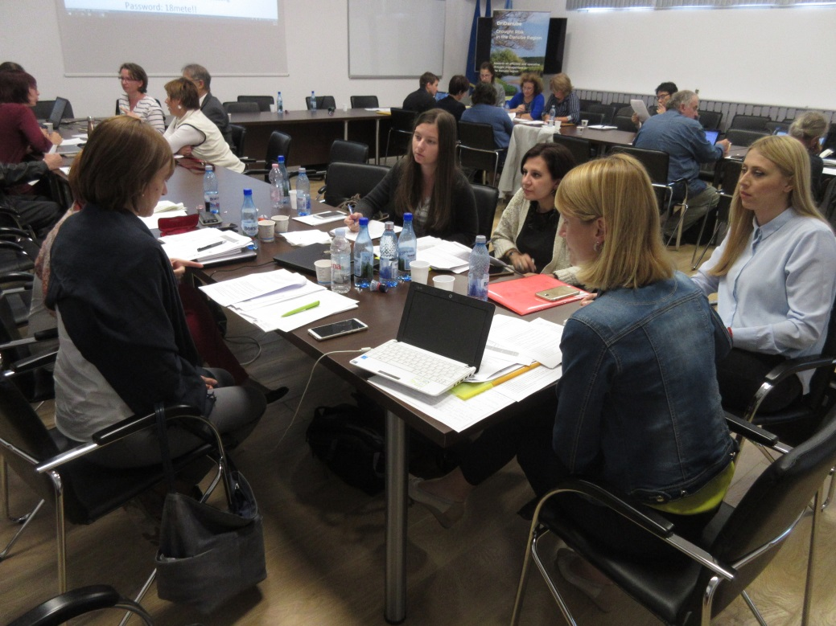
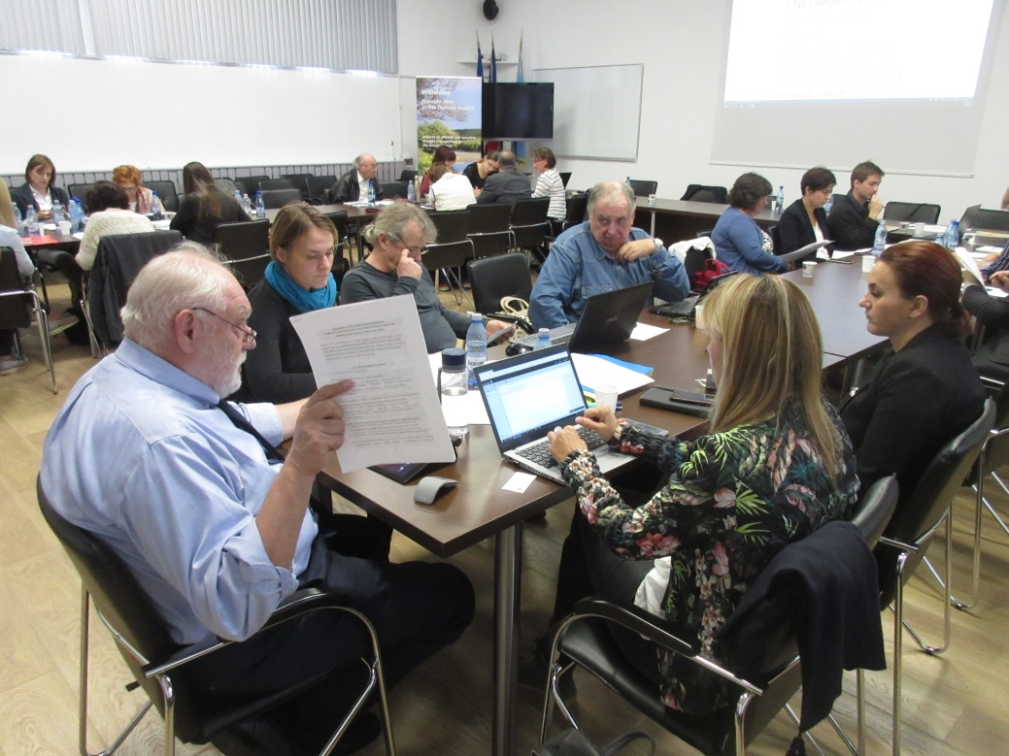
HELP-GWP Consultation Meeting on the Principles in Central and Eastern Europe
Date: 9th October, 2018
Venue: National Meteorological Administration, Bucharest, Romania
Participants: 22 persons from 10 countries
(Ukraine, Moldova, Georgia, Armenia, Romania etc.)

Slide 22
Key Points from Consultation Meetings
Urban/land use planning without causing negative impact
Natural resources management
National risk management plan
Target disasters (local, drought, man-made)
DRR cost is a part of project lifecycle cost
Access to relief aid
Guideline of recovery
Prevent water-borne diseases
Marginalized people (women, youth, human trafficking)
Political will / decision makers
Climate change adaptation
From disaster management to risk management
National assistance in addition to international one
Insurance changes people’s behavior
Insurance supplement government budget

Slide 23
Key Points from Consultation Meetings
Co-financing between public and private sectors
Incentives to private sector
Water pricing, showing benefit and cost of water use
Fee-based management
Beneficially trust fund, international DRR fund
Social and environmental responsibilities of private sector
Effective evacuation by early warning
Transboundary project
Communication facility in communities
Soft investment in education and capacity building
Promote innovation
Interpretation of scientific information
Indigenous knowledge
Media disseminates disaster experiences
Open data on risk

Slide 24
Key Messages of the Principles
1. Water-related disaster risk reduction is indispensable for socio-economic development.
2. Pre-disaster prevention measures should be prioritized.
3. Governments should improve their fiscal systems and secure sufficient budget.
4. Various funding sources should be mobilized.
5. International community should expand financing for disaster risk reduction.
6. Science and technology should support decision making on better investment.
24

Slide 25
Consultations on the Principles
Consultation Meeting
Organized back-to-back with major international conferences and GWP regional meetings
Duration of up to a half day
Introductory presentation followed by group discussions
1st Session on the contents of Principles
2nd Session on the Implementation Plan of the Principles

